Slide 1






FINANCIAL RECONCILIATION AND MONTHLY CLOSING TASK
Presented by Enjey Abd Elsalam

Slide 2
TABLE OF CONTENT
A) DATA PREPARATION
B) RECONCILIATION CRITERIA
C) MONTHLY FINANCIAL DASHBOARD REQUIREMENTS

Slide 3
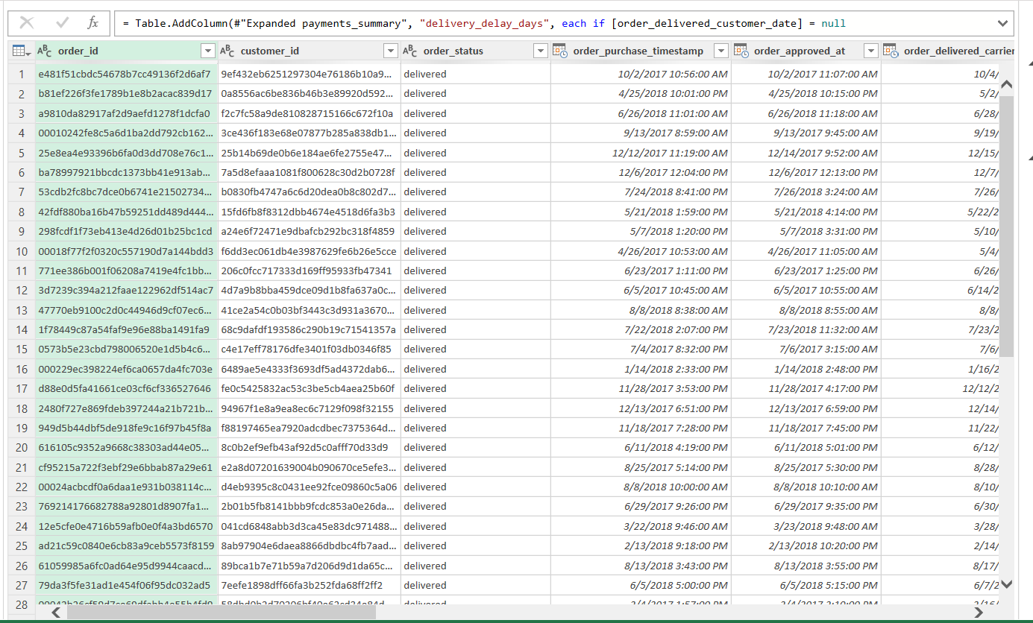

Slide 4
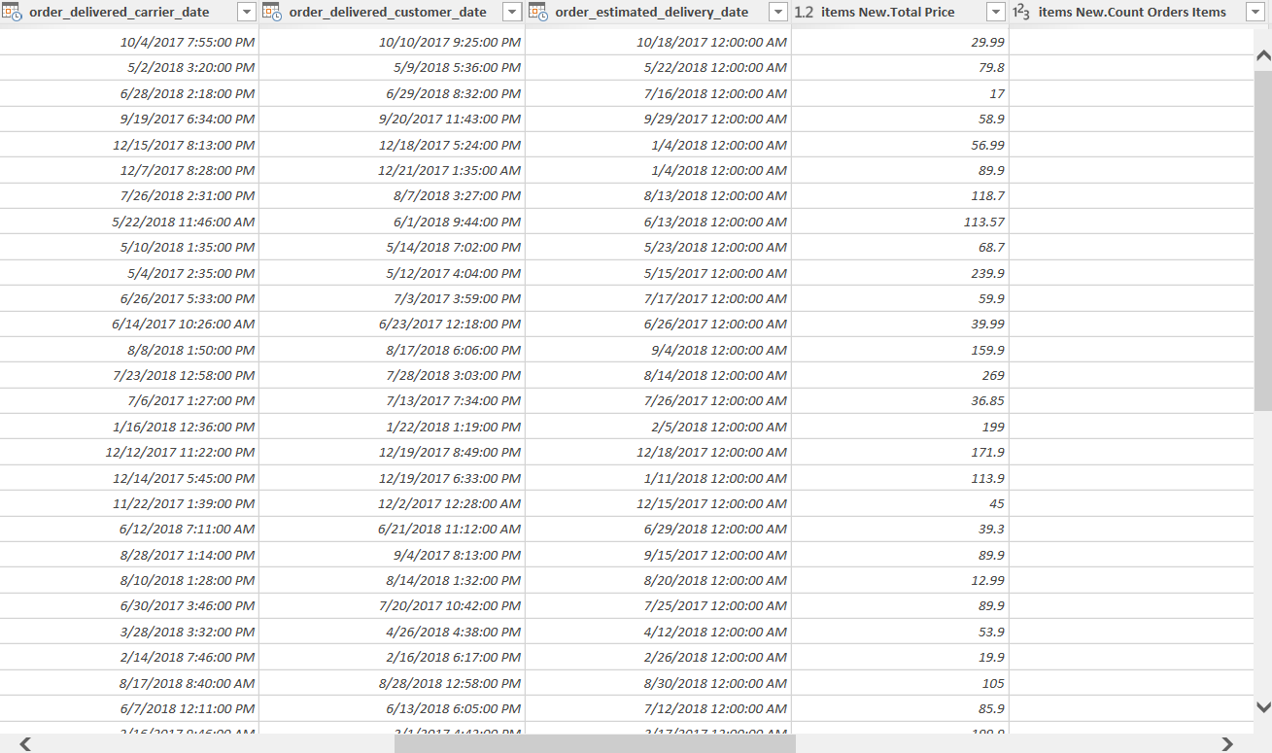

Slide 5
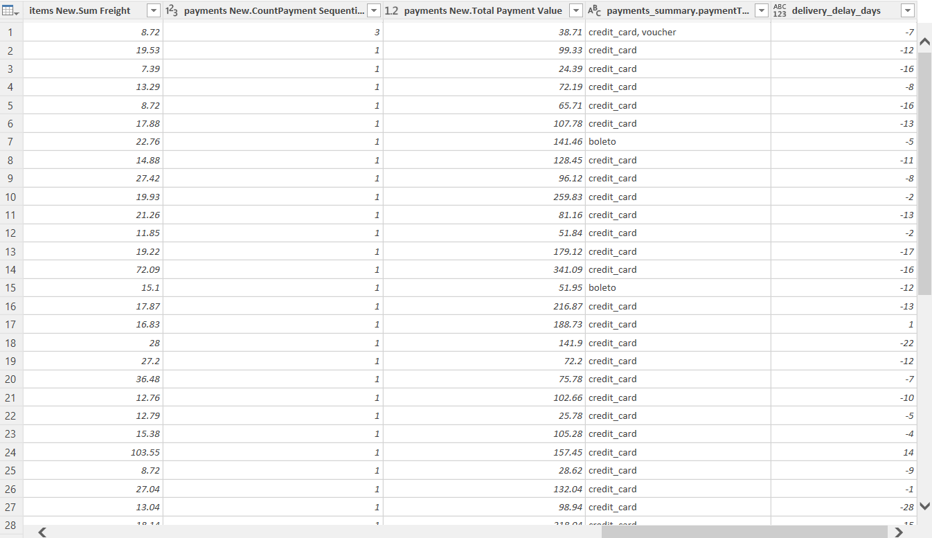

Slide 6
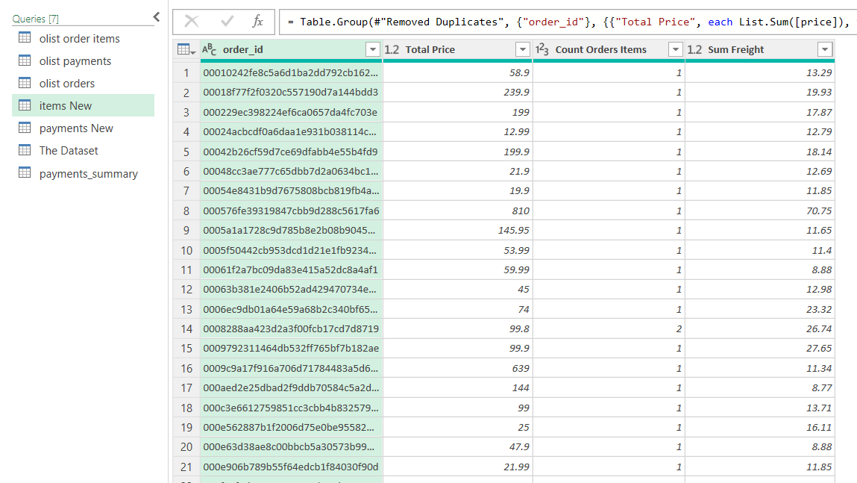

Slide 7
Thank You

